Slide 1

How Screentime affects individual’s Life?
5
4
3
2
1
By :- Avinash Sharma

Slide 2

Screen Time's Impact on Productivity by Age
Age Group 18-22: This group shows significant productivity impact due to high screen time, often linked to social media and entertainment activities.
Age Group 23-27: While also affected, they demonstrate relatively better productivity due to higher engagement in work-related tasks.
5
4
3
2
1

Slide 3

Screen Time's Impact on Productivity by Age
Age Group with the Most Notifications
Age Group 18-22: This group shows significant productivity impact due to high screen time, often linked to social media and entertainment activities.
Age Group 23-27: While also affected, they demonstrate relatively better productivity due to higher engagement in work-related tasks.
5
Age Group 18-22: With frequent social media usage and varied activities, this group experiences the highest notification frequency, averaging up to 100 notifications per day.
Engagement Patterns: Their engagement in work, studies, and social media significantly contributes to high notification counts.
4
3
2
1

Slide 4

Screen Time's Impact on Productivity by Age
Age Group with the Most Notifications
Age Group with Least Interactions and Self-Esteem Effects
Age Group 18-22: This group shows significant productivity impact due to high screen time, often linked to social media and entertainment activities.
Age Group 23-27: While also affected, they demonstrate relatively better productivity due to higher engagement in work-related tasks.
5
Age Group 28-33: This group has lower social interaction frequency, often reporting poor sleep quality and less physical activity.
Impact on Self-Esteem: Reduced interactions contribute to lower self-esteem scores, averaging around 3 out of 5.
Age Group 18-22: With frequent social media usage and varied activities, this group experiences the highest notification frequency, averaging up to 100 notifications per day.
Engagement Patterns: Their engagement in work, studies, and social media significantly contributes to high notification counts.
4
3
2
1

Slide 5
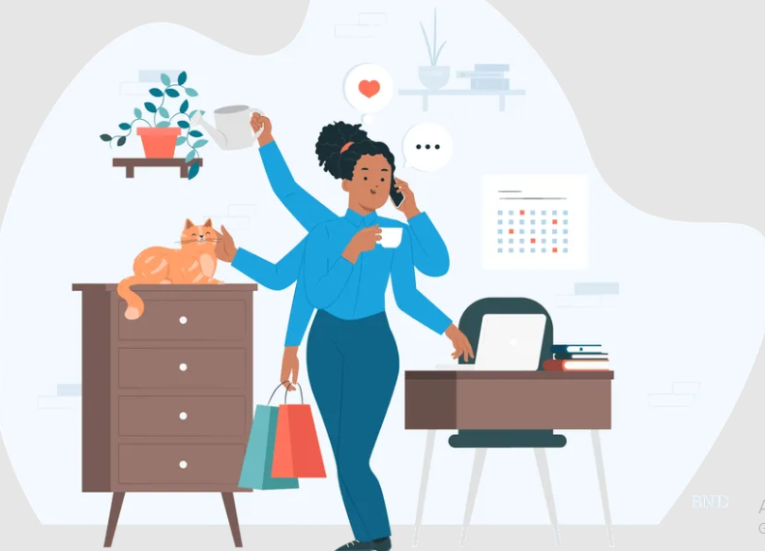
Screen Time's Impact on Productivity by Age
Category of Mobile Users Receiving Most Notifications
Age Group with the Most Notifications
Age Group with Least Interactions and Self-Esteem Effects
Age Group 18-22: This group shows significant productivity impact due to high screen time, often linked to social media and entertainment activities.
Age Group 23-27: While also affected, they demonstrate relatively better productivity due to higher engagement in work-related tasks.
5
Age Group 28-33: This group has lower social interaction frequency, often reporting poor sleep quality and less physical activity.
Impact on Self-Esteem: Reduced interactions contribute to lower self-esteem scores, averaging around 3 out of 5.
Age Group 18-22: With frequent social media usage and varied activities, this group experiences the highest notification frequency, averaging up to 100 notifications per day.
Engagement Patterns: Their engagement in work, studies, and social media significantly contributes to high notification counts.
Young Adults (18-22): Their extensive use of social media and entertainment leads to the highest notification rates, averaging 80 to 100 notifications daily.
Variety of Activities: Frequent engagement across different platforms enhances their notification load.
4
3
2
1

Slide 6
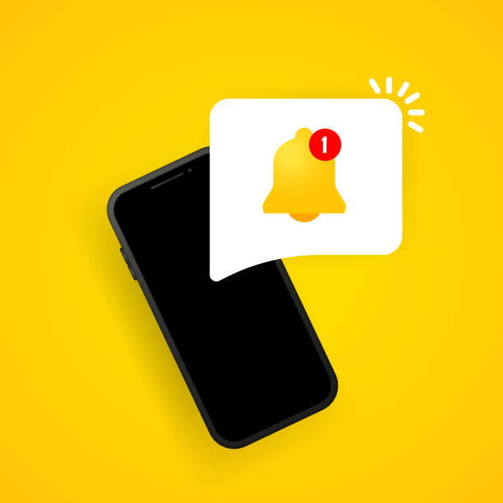
Screen Time's Impact on Productivity by Age
Category of Mobile Users with Least Productivity
Category of Mobile Users Receiving Most Notifications
Age Group with the Most Notifications
Age Group with Least Interactions and Self-Esteem Effects
Age Group 18-22: This group shows significant productivity impact due to high screen time, often linked to social media and entertainment activities.
Age Group 23-27: While also affected, they demonstrate relatively better productivity due to higher engagement in work-related tasks.
5
Age Group 28-33: This group has lower social interaction frequency, often reporting poor sleep quality and less physical activity.
Impact on Self-Esteem: Reduced interactions contribute to lower self-esteem scores, averaging around 3 out of 5.
Age Group 18-22: With frequent social media usage and varied activities, this group experiences the highest notification frequency, averaging up to 100 notifications per day.
Engagement Patterns: Their engagement in work, studies, and social media significantly contributes to high notification counts.
Young Adults (18-22): High screen time and distractions from social media contribute to their lower productivity levels.
Mixed Engagement: Despite some work-related tasks, entertainment and social media usage detract significantly from their overall productivity.
Young Adults (18-22): Their extensive use of social media and entertainment leads to the highest notification rates, averaging 80 to 100 notifications daily.
Variety of Activities: Frequent engagement across different platforms enhances their notification load.
4
3
2
1

Slide 7

Screen Time's Impact on Productivity by Age
Category of Mobile Users with Least Productivity
Category of Mobile Users Receiving Most Notifications
Age Group with the Most Notifications
Age Group with Least Interactions and Self-Esteem Effects
Age Group 18-22: This group shows significant productivity impact due to high screen time, often linked to social media and entertainment activities.
Age Group 23-27: While also affected, they demonstrate relatively better productivity due to higher engagement in work-related tasks.
5
Age Group 28-33: This group has lower social interaction frequency, often reporting poor sleep quality and less physical activity.
Impact on Self-Esteem: Reduced interactions contribute to lower self-esteem scores, averaging around 3 out of 5.
Age Group 18-22: With frequent social media usage and varied activities, this group experiences the highest notification frequency, averaging up to 100 notifications per day.
Engagement Patterns: Their engagement in work, studies, and social media significantly contributes to high notification counts.
Young Adults (18-22): High screen time and distractions from social media contribute to their lower productivity levels.
Mixed Engagement: Despite some work-related tasks, entertainment and social media usage detract significantly from their overall productivity.
Young Adults (18-22): Their extensive use of social media and entertainment leads to the highest notification rates, averaging 80 to 100 notifications daily.
Variety of Activities: Frequent engagement across different platforms enhances their notification load.
4
3
2
1

